Slide 1
IMUS TV
Android TV App Project

Slide 2
AGENDA
1.
2.
3.
Modules & Features Recap
Current Progress
Prototype Demonstration

Slide 3
1.
Modules & Features Recap

Slide 4
Modules and Features Recap
Video Streaming
Live TV
LGU Live Streaming
LGU Broadcast of news, events, etc.
Announcement
LGU Community Announcments
Disaster Warnings

Slide 5
Modules and Features Recap
Notification
Games
Display the notifications to the users such as notification for chance to upgrade their internet speed.
Events
Games that offers free internet speeds.
Games are different every day and randomized each week (Tentative)
LGU Community Events

Slide 6
2.
Current Progress

Slide 7
Current Progress
Flutter Mobile App
(Client Side)
Laravel Web App
(Backend)
Main application of the project. This is the application which will be use by users.
This is the application where the data and resources needed by the Imus TV is stored and retrieve.
API

Slide 8
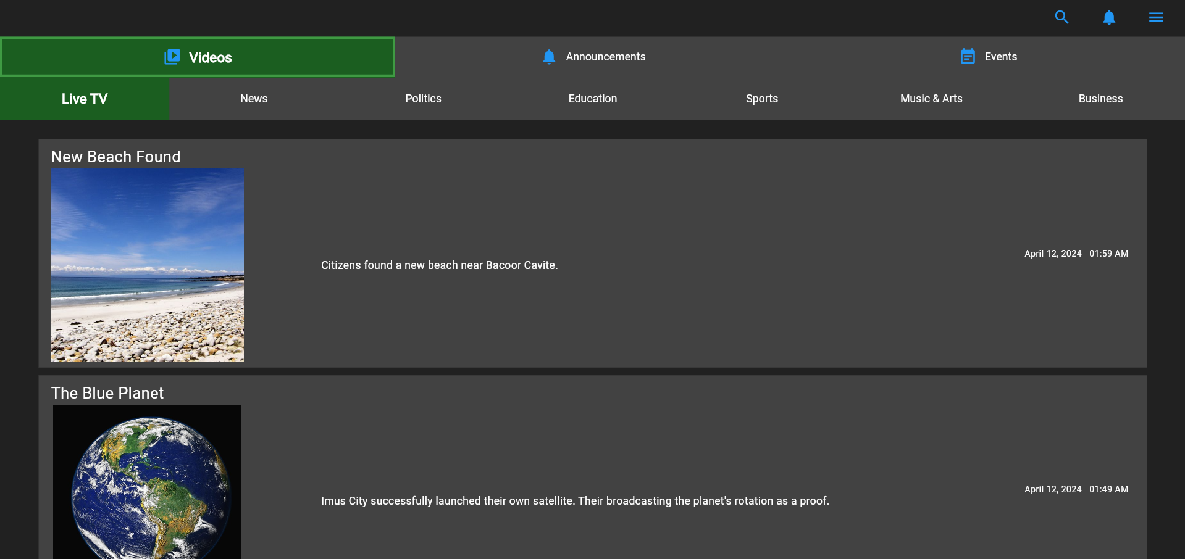
IMUS TV (Flutter App)

Slide 9
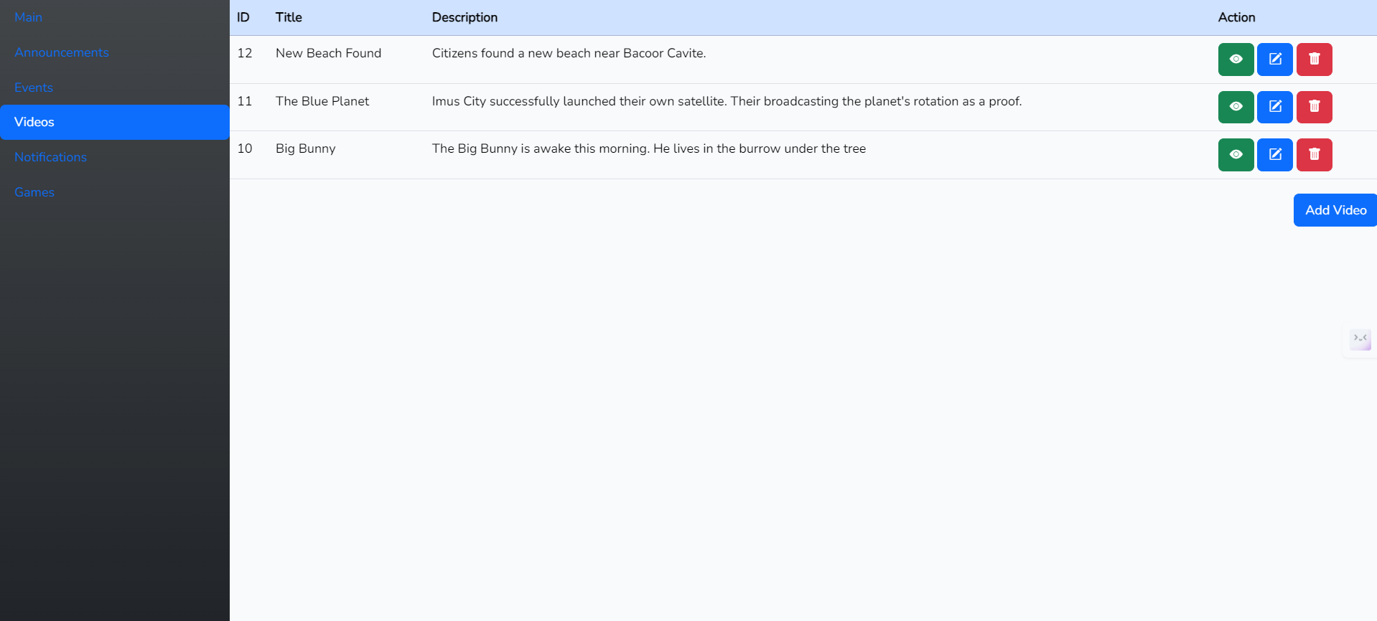
Laravel App (Backend Prototype)

Slide 10
3.
Prototype Demonstration

Slide 11
Thank You

